Slide 1

Introduction to Software Business Product management
Week 2 Day 2
Led by: Emily Crose
for
Oakland University

Slide 2
Review of day 1

Slide 3


Questions From Day 1?

Slide 4
Terms to listen for
Cache
A small portion of RAM set aside for temporary storage for frequently accessed data
Process Register
A quickly accessible location available to a computer processor
Heap & Stack
Memory management methods

Slide 5
The Software Development Life Cycle
Notes:
Over the last couple of days, we’ve talked a lot about the types of software we may interact with in our lives. We now have a sense of scale of how large of a project it is to build an app, so the question for us becomes; how do we approach this project with as much organization as possible? That’s where the software development life cycle comes into play

Slide 6
What is the Software Development Life Cycle?
The SDLC helps us organize the process of building software
Includes steps for building, revising, and deploying software
Includes roles associated with each step along the building process

Slide 7
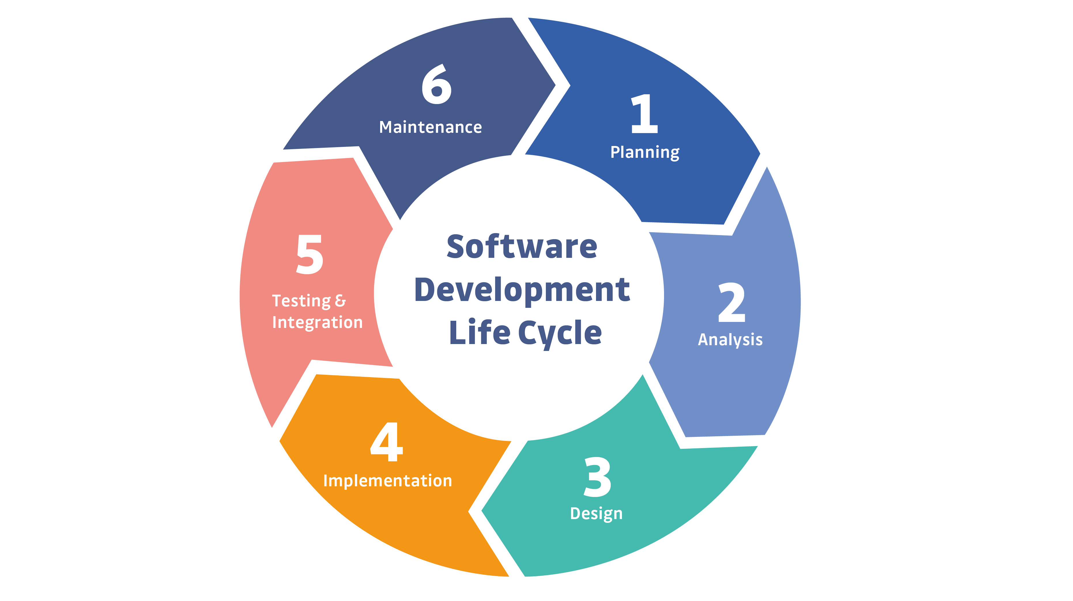
Notes:
This is a simple example of the SDLC. Typically, representations of the SDLC will have around 6 steps, but the steps will generally match what you see here.

Slide 8

Review Day 2

Slide 9

Question or clarifications?

Slide 10

Preview day 3

Slide 11

See you next time!

